Slide 1
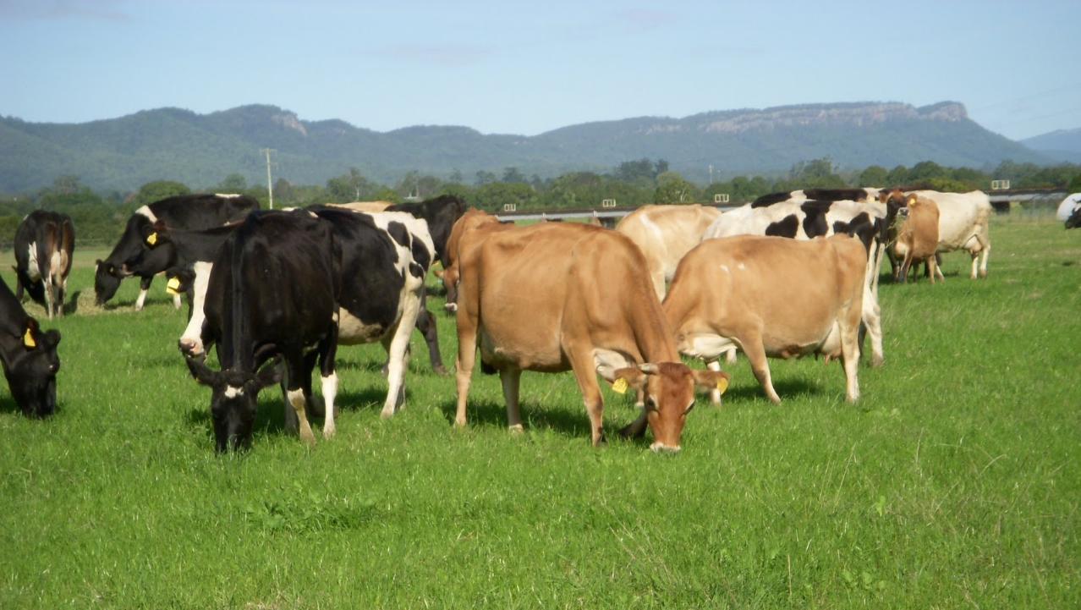


P fert recommendations
and
accounting for PBI
Dr Bill Cotching
Soil Management Consultant
www.billcotching.com

Slide 2
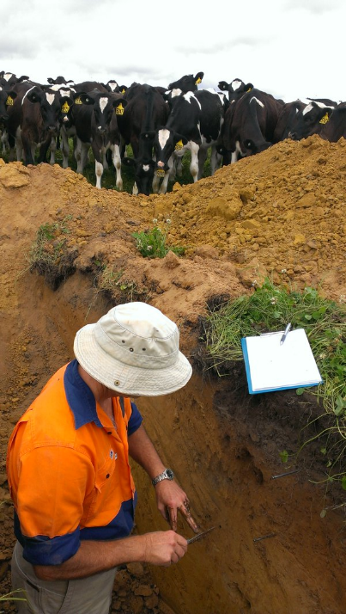

Photo by James Hills
Phosphorus = "bearer of light“
Greek
Acknowledge:
Dr Lucy Burkitt
Dr Jess Coad

Slide 3

The friction of the match against the red phosphorous transforms a little bit of the red phosphorus into white phosphorus, providing the ignition needed to light the match,

Slide 4
Influence of sampling depth
Soil analysis range & influence of PBI on P ranges
Olsen vs Mehlich
Variability around the farm (right place)
Maintenance and capital fertiliser rates
Budgeted inputs and outputs (right rate)
Rates of decline
Single vs multiple applications (right time)
Products (right product)

Slide 5
Sampling depth
Coad, Burkitt, and Gourley 2010
On most soil types, Olsen P and Colwell P soil test results
1.19 and 1.18
Can be used when converting between 75 and 100mm sample depths.
We found there was no significant difference in P and K concentrations between the different depths in soils which had very low P sorption capacities, high sand contents, and were located in high rainfall zones.

Slide 6

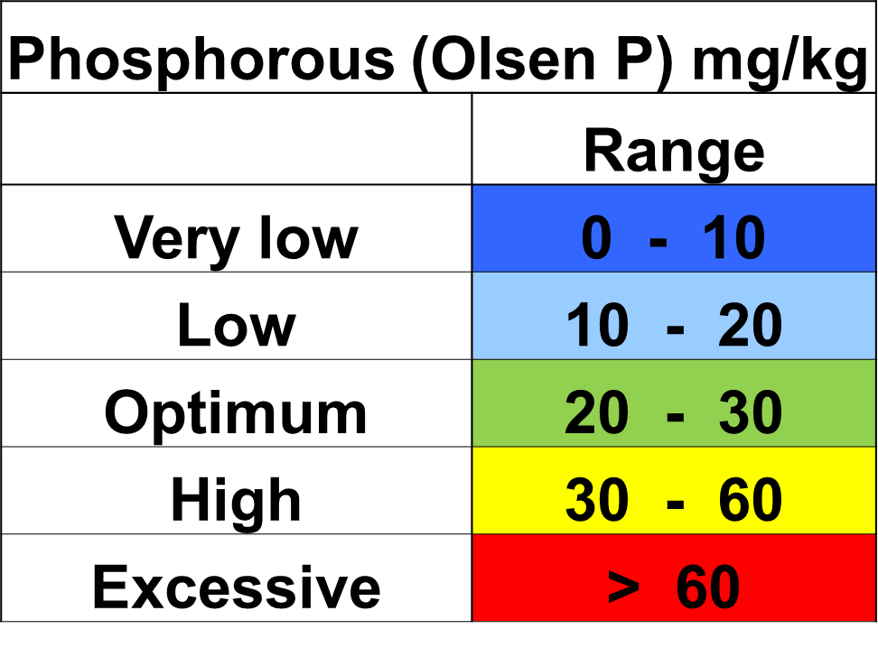
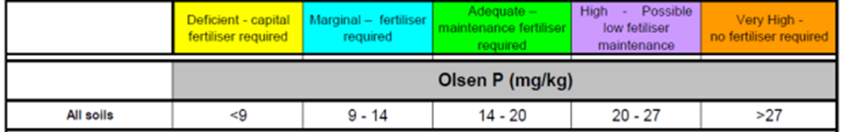
Soil analysis ranges – Olsen P; 75 mm depth
Ranges 0-100 mm depth (Victoria)

Slide 7
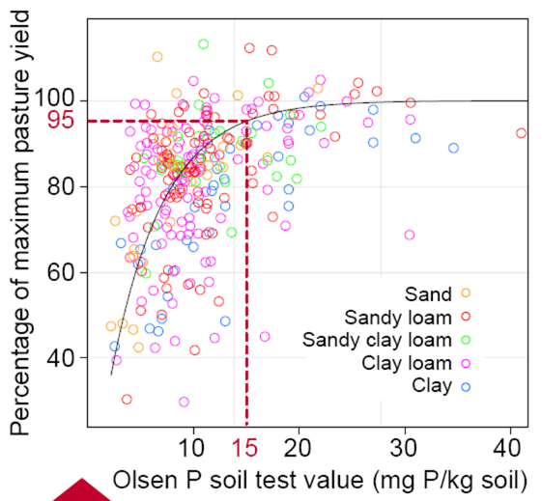
Making Better Fertiliser Decisions – Gourley, Melland, Waller, Awty, Smith, Peverill, Hannah 2007

Slide 8
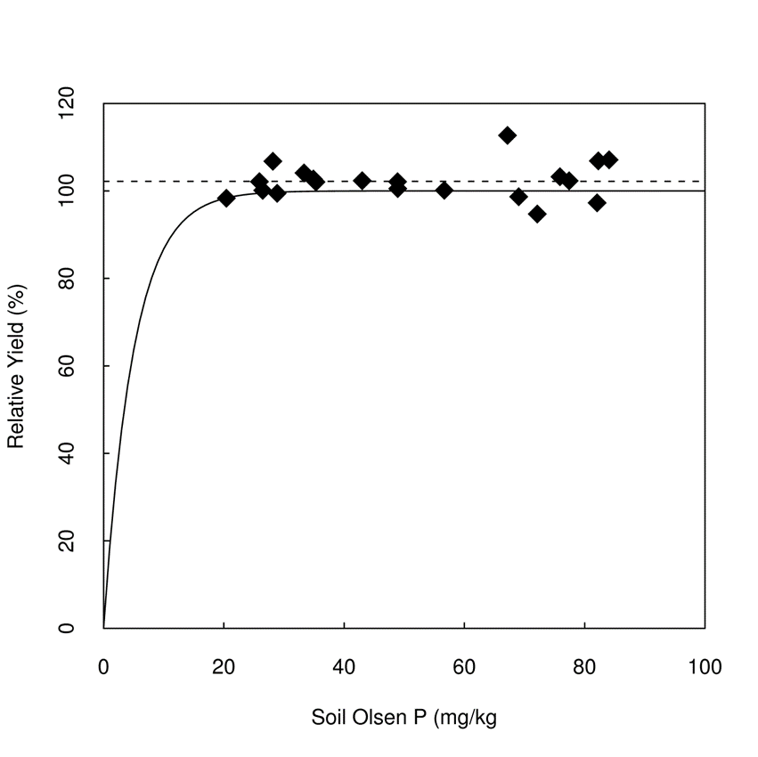

Tasmania
There was no increase in pasture production
when soil Olsen P concentrations exceeded 23 mg/kg (0 - 75 mm).
Production ranged from 18.4 – 21.8 T DM/yr (Togari rainfed)

Slide 9
NZ targets (Tillman, Roberts and Manning 2012)
Recommend target Olsen P range 25 – 40
Depends on production, payout, irrigation, N use, compaction

Slide 10
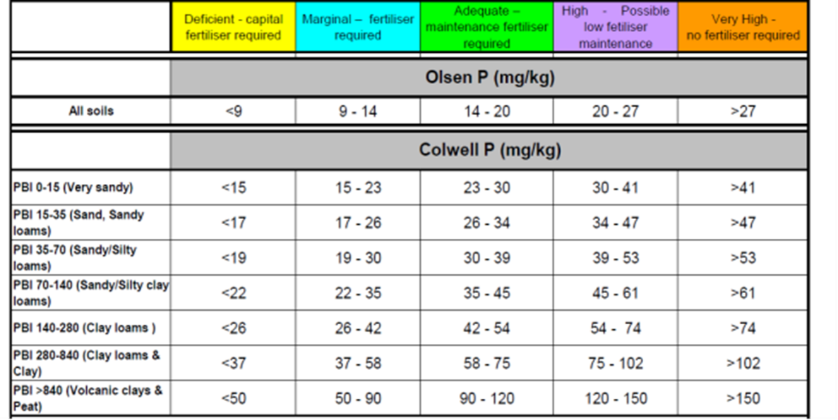
Phosphorus buffering index - PBI
Burkitt et al. 2002.

Slide 11
Olsen vs Mehlich P test - Sawyer 2004 (Iowa, USA)
Olsen P = 2.1 + 0.47 Mehlich P

Slide 12
Variability around the farm
Gourley, Aarons, Hannah, Awty, Dougherty, Burkitt 2014
Paddocks closer to the milking shed are more likely to be grazed more frequently, and
hence will have a higher number of cow days /ha/year (increased dung load)
Olsen P concentration doubled in the 0–5 cm layer below a dung pat after 40 days
also more likely to receive mechanically applied effluent, as they are closer to effluent ponds

Slide 13
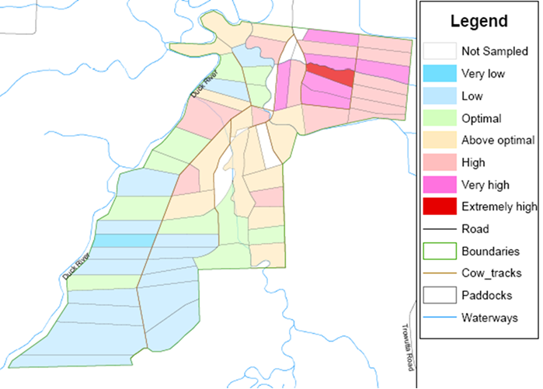
Olsen P

Slide 14
Maintenance P fertiliser rates
NutriMatch©
P budget - Soil factors for maintenance fertiliser applications
Phosphorus (Olsen P : 0-75 mm)
8-10 11-13 14-17 18-25 26-35+
Sand 6 8 9 10 10
Sandy Loam 10 15 18 20 20
Clay Loam 13 20 23 25 25
Clay/Red Soil 16 24 28 30 30

Slide 15
Nutrient budget: feed/grain input
milk/meat output
Milk Grain Fodder Liveweight
(% per kg milk) (kg/tonne DM) (kg/tonne DM) (kg/100kg live wt)
Phosphorus 0.1 3 3 8
Phosphorus balance ranged from –7 to 133 kg P/ha/year
(Gourley et al 2012. Accounting for nutrients project)

Slide 16
Nutrimatch – Dairy Tas website
P budget: production /ha comparison
5000 litres/ha

Slide 17
P budget: production /ha comparison
15000 litres/ha

Slide 18
P budget – concentrates and fodder make a difference

Slide 19
Capital fertiliser rates
 | PBI | Amount of P fert to raise Olsen P by 1 unit | Amount of P fert to raise Colwell P by I unit
 |  | kgP/ha | kgP/ha
sand | < 50 | 6 | 22
sandy loam | 50 - 100 | 8 | 23
Sandy clay loam | 100 - 300 | 9 | 25
Clay loam | 300 - 400 | 10 | 28
Clay/red soil | > 400 | 12 | 32

Slide 20
Rate of soil phosphorus decline
Coad, Burkitt, Dougherty, Sparrow 2014
Decrease in Olsen P (mg/kg) over 4.5 years
- no added fertiliser
Initial Decrease
Olsen P in Olsen P
Red Ferrosol 35 9.4 red clay loam
Brown Kurosol 41 12.0 duplex loam
Brown Dermosol 33 3.0 silty clay loam
Hydrosol 38 11.7 wet sandy loam

Slide 21
Rate of soil phosphorus decline
Coad, Burkitt, Dougherty, Sparrow 2014
Decrease in Olsen P (mg/kg) over 4.5 years
- no added fertiliser
Initial Decrease
Olsen P in Olsen P
Red Ferrosol 100 35 red clay loam
Brown Kurosol 90 25 duplex loam
Brown Dermosol 55 15 silty clay loam
Hydrosol 60 28 wet sandy loam

Slide 22
Single vs multiple applications
Burkitt, Donaghy, Smethurst 2010
Site Initial Olsen P
Elliott 22
Mt Hicks 21
Togari 49
P fertiliser had no effect on pasture production across the 3 sites, regardless of rate or the season in which the P was applied, confirming that no P fertiliser is required when when soil P concentrations are adequate.
Applying P fertiliser as a single annual application in summer
did not compromise pasture production
Supports the current environmental recommendations of applying P fertiliser
during drier conditions, when the risk of surface P runoff is generally lower.
Timing of fertiliser application:
Once in spring
Once in summer
Once in autumn
Three times in spring/summer
Twice in autumn

Slide 23
Tasmanian nutrient loss rates to rivers
from irrigated pastures
are at the higher end of published values
total Phosphorus 10 - 12 kg/ha/yr
Broad & Corkrey 2011

Slide 24
Phosphorus fertilisers
Single superphosphate 0:9:0:11
Triple superphosphate 0:21:0:1
DAP (Di-Ammonium phosphate) 18:20:0:1.6
MAP (Mono-Ammonium phosphate) 10:22:0:1.5
Blends

Slide 25
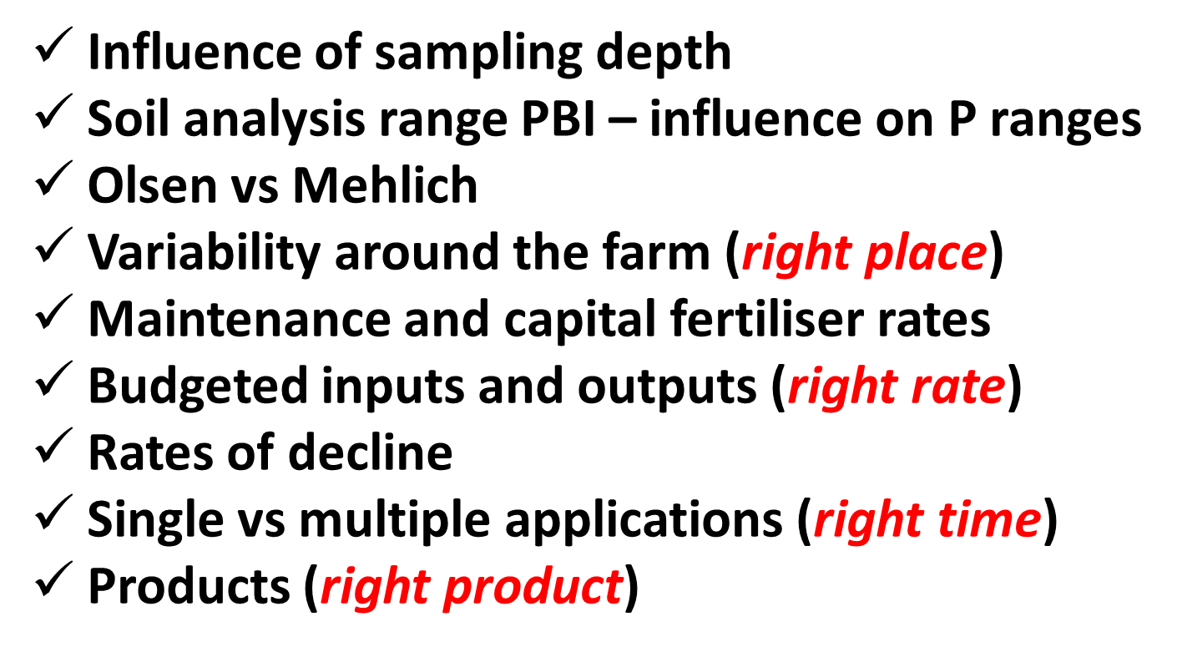

Slide 26
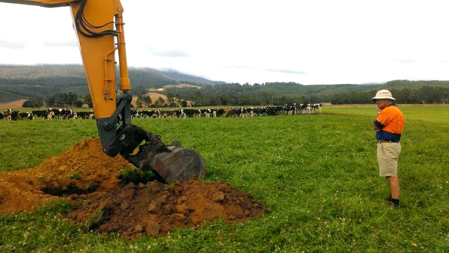


Questions & comments
Photo by James Hills

